Slide 1




Topic 1
Introduction to Systems Analysis and Design
SYSTEMS ANALYSIS AND DESIGN

Slide 2


CONTENT
SEGI UNIVERSITY
01
Importance and objectives
02
Systems
03
The role of a systems analyst
04
Overview of the Systems Development Life Cycle (SDLC)

Slide 3



What’s the SAD about?
Input
Process
Output
Systems Development Process
Products
Planning
Ideas
Services
Implementation
Analysis
Business case
Design
Profit (product or efficiency)
Cash
SAD is about getting people, processes and technology together to sort out the bit in the middle!

Slide 4


Systems Analysis and Design (SAD)
SEGI UNIVERSITY
Systems Analysis and Design (SAD) is a structured approach to developing information systems that meet business needs.
It involves two main activities: analysis, which focuses on understanding problems, requirements, and the existing system; and design, which translates those requirements into a blueprint for building the new system.
SAD helps bridge the gap between users and developers by using models, diagrams, and methodologies to ensure the final system is effective, efficient, and user-friendly.
It is a core skill for IT students, as it teaches students how to transform business requirements into practical technology solutions.

Slide 5
Why is SAD important?
✔ Helps understand user needs
✔ Saves time and money
✔ Reduces mistakes
✔ Improves quality and performance
SEGI UNIVERSITY

Slide 6
SAD Is Good for Your Career!
SEGI UNIVERSITY
This module will equip YOU with the knowledge and skills required to become a Systems Analyst and significantly help you to contribute to the systems development process organisations use to develop products and/or services:
……to sell to others
….. to improve their own business
Notes:
Whether you are in Business IT, Soft Eng or Comp Sci

Slide 7
SEGI UNIVERSITY
WHAT IS A SYSTEM?

Slide 8
Computer-based Systems
System
an interrelated set of components/functions working together to achieve a common purpose
Computer-based System
Uses computer hardware and software technology to perform, support or integrate system functions
Categorised according to importance of time
Batch
Interactive online
Real-time
Developed to solve an organisational problem or meet a market demand
SEGI UNIVERSITY

Slide 9
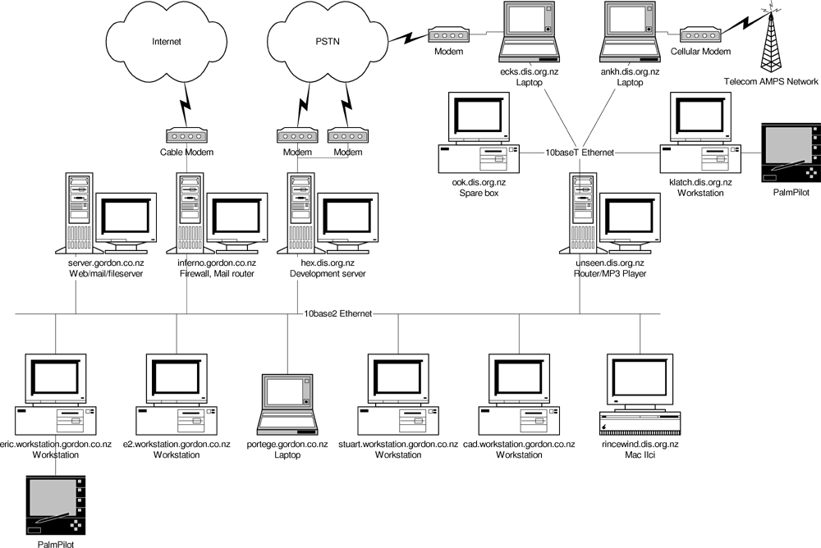
Information Systems
Information Systems is ‘an arrangement of people, data, processes, interfaces, and information technology that interact to support and improve day-to-day business operations, as well as support the problem solving and decision making needs of management and users.’

Slide 10
Business Information System
SEGI UNIVERSITY
Computer-based systems that perform basic business functions
Underlying purpose here is to enhance business performance and increase revenue
The creation and manipulation of Business Information is key.
Software developed to perform a business process in a specific way

Slide 11
Key Properties of Computer-based Systems
SEGI UNIVERSITY
Data
Raw facts that describe people, objects and events in an organisation
Little meaning
Used to create information
Information
Data that has been refined, organised and processed in a manner suitable for human interpretation
Notes:
Data
Raw facts that describe people, objects and events in an organisation
E.g., Invoice number, Date of birth, Forename, Salary, Male, number of phones sold..etc
Little meaning in and of themselves
By-product of business activities
Information
Data that has been refined, organised and processed in a manner suitable for human interpretation
People provide purpose and intelligence to collections of processed data
For the past five years, there has been a consistent 70% reduction in the sales of student textbooks each year between October and December. We appear to overstock books as we have a high surplus each year. We should manage stock levels to reflect this time sensitive pattern.

Slide 12
Key Properties of Computer-based Systems (Cont.)
SEGI UNIVERSITY
Processes
Activities that help to perform system functions
Interfaces
How the system interfaces with its users and/or other computer systems
Communications (Networks)
A computer system’s data, processes and interfaces are layered onto networks to enable it to function across different geographical locations
i.e. telecommunication technologies, internet technologies, intranetworking

Slide 13
Types of Systems
SEGI UNIVERSITY
Transaction Processing System (TPS)
Handles day-to-day business operations.
Example: Point-of-Sale (POS) system in retail.
Management Information System (MIS)
Summarizes and reports routine operations for managers.
Example: Monthly sales reports, inventory status.
Decision Support System (DSS)
Helps managers make semi-structured decisions using data analysis.
Example: Forecasting sales trends.
Executive Information System (EIS)
Provides top executives with dashboards and summaries for strategic decisions.
Example: Corporate performance dashboards.

Slide 14
Quiz
SEGI UNIVERSITY
What does a system mean?
A single app
A set of components working together
A type of software
Systems Analysis is about:
Buying a system
Understanding how a system works
Making games
Why is design important in systems?
To improve the look of system
To make sure it don’t fails
To plan how the system works properly

Slide 15

SYSTEM DEVELOPMENT LIFE CYCLE (SDLC)
SEGI UNIVERSITY
The systems development life cycle (SDLC) is the process of determining how an information system (IS) can support business needs, designing the system, building it, and delivering it to users.

Slide 16

Key person in the SDLC
SEGI UNIVERSITY
Systems analyst
who analyzes the business situation, identifies the opportunities for improvements, and designs the system to implement the improvements.

Slide 17
SYSTEMS ANALYST
The systems analyst plays a key role in IS development projects.
The systems analyst works closely with all project team members so that the team develops the right system in an effective way.
Systems analysts must understand how to apply technology in order to solve problems.
Systems analysts may serve as change agents who identify organizational improvement needed and design systems to implement those changes.
SEGI UNIVERSITY

Slide 18
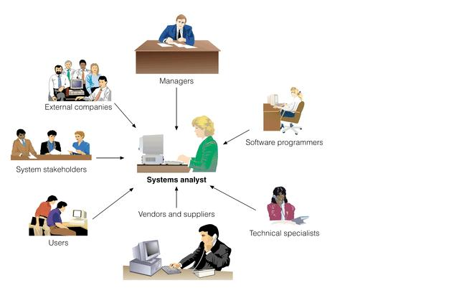
SYSTEMS ANALYST
SEGI UNIVERSITY

Slide 19
Systems Analyst Skills
Technical
must understand the technical environment, technical foundation, and technical solution.
must understand how it can be applied to business situations.
Analytical
Management
need to manage people and to manage pressure and risks.
Interpersonal
Ethical
must deal fairly, honestly, and ethically with other project members, managers, and systems users.
Business
must be problem solvers
need to communicate effectively
SEGI UNIVERSITY

Slide 20
Systems Analyst Roles
Business analyst
focuses on the business issues surrounding the system.
Change management analyst
focuses on the people and management issues surrounding the system installation
Systems analyst
focuses on the is issues surrounding the system.
Infrastructure analyst
focuses on technical issues
Project manager
ensures that the project is completed on time and within budget, and that the system delivers the expected value to the organization
SEGI UNIVERSITY

Slide 21
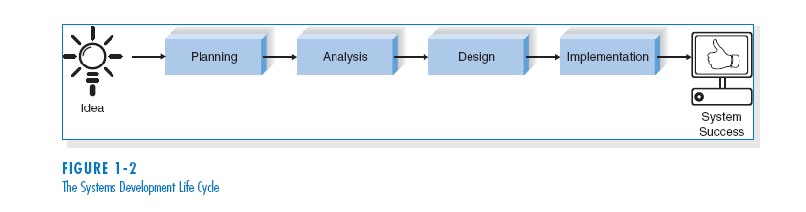
SYSTEMS DEVELOPMENT LIFE CYCLE (SDLC)
SEGI UNIVERSITY

Slide 22
SYSTEMS DEVELOPMENT LIFE CYCLE (SDLC)
SEGI UNIVERSITY
The SDLC is composed of four fundamental phases:
Planning
Analysis
Design
Implementation
Each of the phases is composed of steps, which rely on techniques that produce deliverables (specific documents that explain various elements of the system).

Slide 23
Planning
This phase is the fundamental process of understanding why an information system should be built, and determining how the project team will go about building it.
SEGI UNIVERSITY
Steps in Planning Phase
1. During project initiation, the system’s business value to the organization is identified (how will it lower costs or increase revenues ?).
2. During project management, the project manager creates a work plan, staffs the project, and puts techniques in place to help the project team control and direct the project through the entire SDLC.

Slide 24
Analysis
SEGI UNIVERSITY
The analysis phase answers the questions of who will use the system, what the system will do, and where and when it will be used.
During this phase the project team investigates any current system(s), identifies improvement opportunities, and develops a concept for the new system.

Slide 25
Analysis Phase
SEGI UNIVERSITY
Steps in Analysis Phase
Analysis strategy
Requirements gathering
System proposal
This is developed to guide the projects team’s efforts. This includes a study of the current system and its problems, and predicting ways to design a new system.
The analysis of this information leads to the development of a concept for a new system. This concept is used to build a set of analysis models.
The proposal is presented to the project sponsor and other key individuals who decide whether the project should continue to move forward.

Slide 26
Design
SEGI UNIVERSITY
The design phase decides how the system will operate, in terms of the hardware, software, and network infrastructure
The user interface, forms, and reports that will be used
The specific programs, databases, and files that will be needed.

Slide 27
Design Phase
SEGI UNIVERSITY
Design strategy: this clarifies whether the system will be developed by the company or outside the company (vendor).
Architecture design: this describes the hardware, software, and network infrastructure that will be used.
Database and file specifications: these documents define what and where the data will be stored.
Program design: defines what programs need to be written and what they will do.

Slide 28
Implementation
SEGI UNIVERSITY
During the implementation phase, the system is either developed or purchased (in the case of packaged software) and installed.
This phase is usually the longest and most expensive part of the process.

Slide 29
Implementation phase
SEGI UNIVERSITY
System construction
Installation
Support plan
The system is built and tested to make sure it performs as designed.
The old system is turned off and the new one is turned on.
Includes a post-implementation review as well as a systematic way for identifying changes needed for the system.

Slide 30




Question Time

Slide 31
WHAT WE COVER NEXT...
SEGI UNIVERSITY
02 Project Initiation and Planning

